Slide 1
Microsoft Azure IoT Reference Architecture

Slide 2
Reference Architecture Guiding Principles
Heterogeneity
Accommodates for a vast variety of scenarios, environments, devices, processing patterns, and standards
Security
Considers security and privacy measures across all areas
Hyper-scale deployments
Supports millions of connected devices
Flexibility Allows for composability and extensibility to enable the usage of various first-party or third-party technologies

Slide 3
Azure IoT Reference Architecture
Device Connectivity
Data Processing, Analytics and Management
Presentation & Business Connectivity
IP capable devices
Cloud Gateway
Stream Processing and Analytics (hot and cold paths)
Solution UX
IoT Client
Personal mobile devices
Existing IoT devices
Application Business Logic
IoT Client
Field Gateway
Business Integration Connectors and Gateway(s)
Resource constrained devices
Business systems
IoT Client
Device Provisioning and Management
Data Path
Optional solution component
IoT solution component

Slide 4
Device Connectivity
Device
AMQP, HTTPS
IoT Hub
IoT Client
Protocol Gateway
(Cloud Service, VM)
Device
MQTT, Custom Protocols
IoT Client
Device
Field Gateway*
AMQP, HTTPS
CoAP, AllJoyn, OPC
Device
IoT Client
Device
Field Gateway*
Protocol Gateway
(Cloud Service, VM)
OPC, HTTP, CoAP
CoAP, AllJoyn, OPC
Device
VPN/ExpressRoute
Data Path
* Field Gateway is currently a concept that may represent Microsoft, 3rd party or custom capabilities at a hardware or software level
Optional solution component
Azure IoT solution component

Slide 5


Azure IoT Services
Device Connectivity
Data Processing, Analytics and Management
Presentation & Business Connectivity
IP capable devices
Cloud Gateway
Stream Processing and Analytics
Solution UX
IoT SDK
Personal mobile devices
Existing IoT devices
Application Business Logic
IoT SDK
Field Gateway
Business Integration Connectors and Gateway(s)
Resource constrained devices
Business systems
IoT SDK
Device Provisioning and Management
Data Path
Optional solution component
IoT solution component

Slide 6
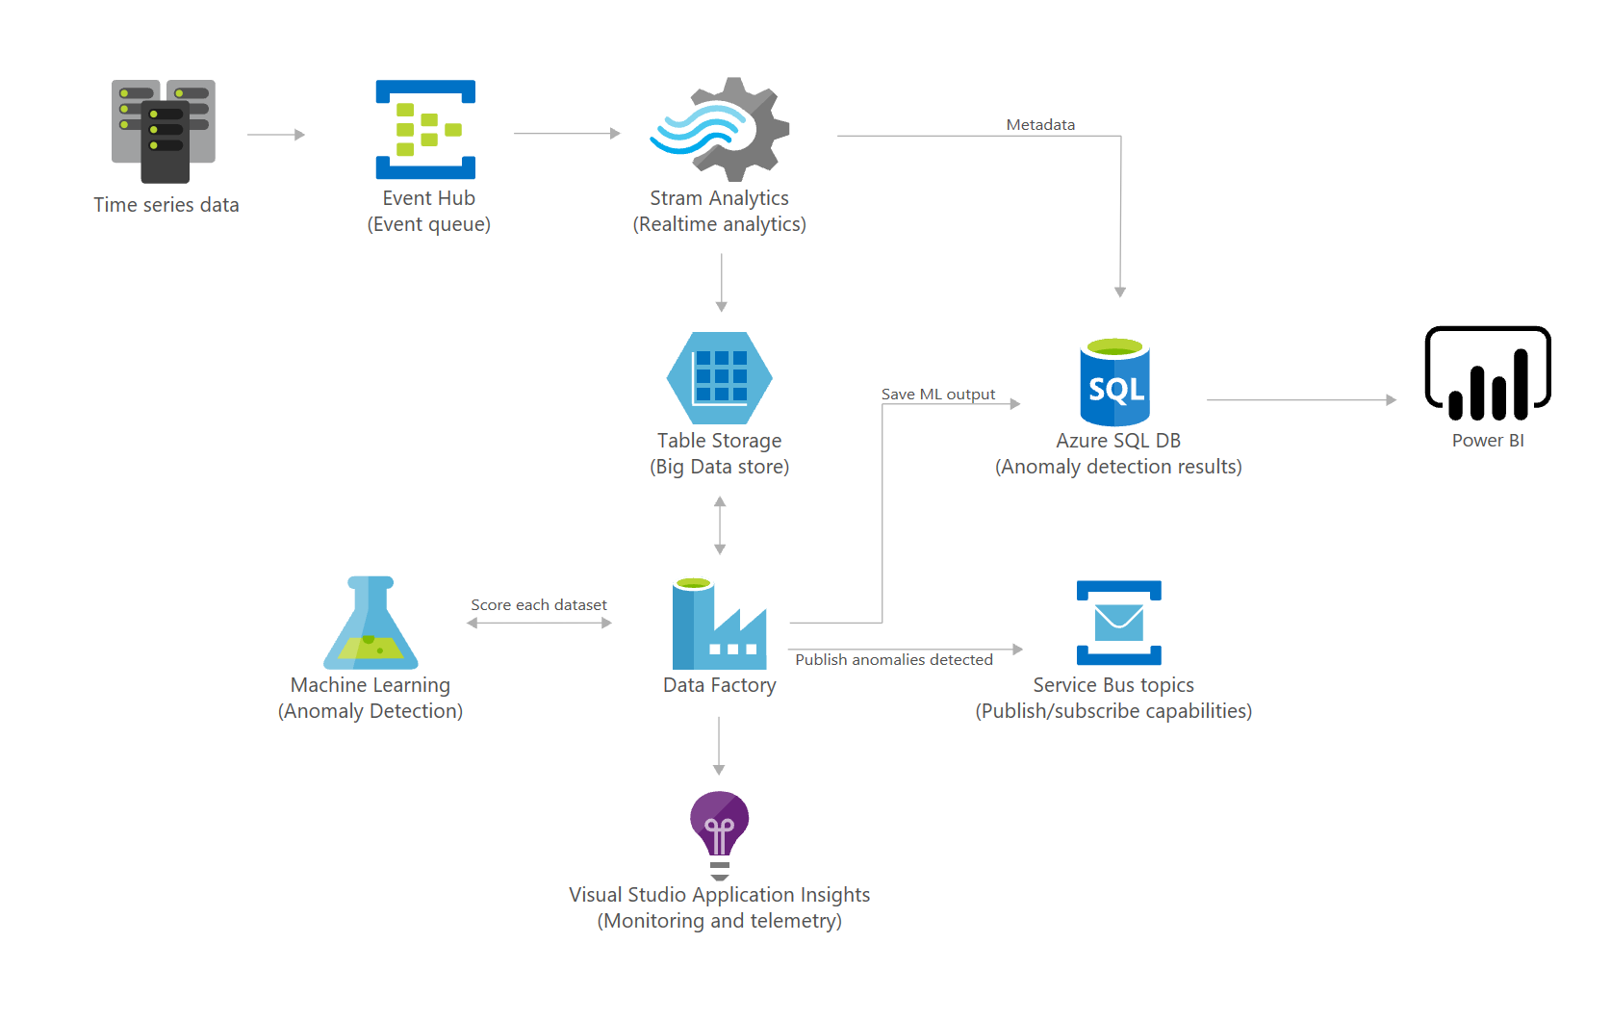
Solution architectures
Visit for more: https://azure.microsoft.com/en-us/solutions/architecture/?solution=internet-of-things

Slide 7
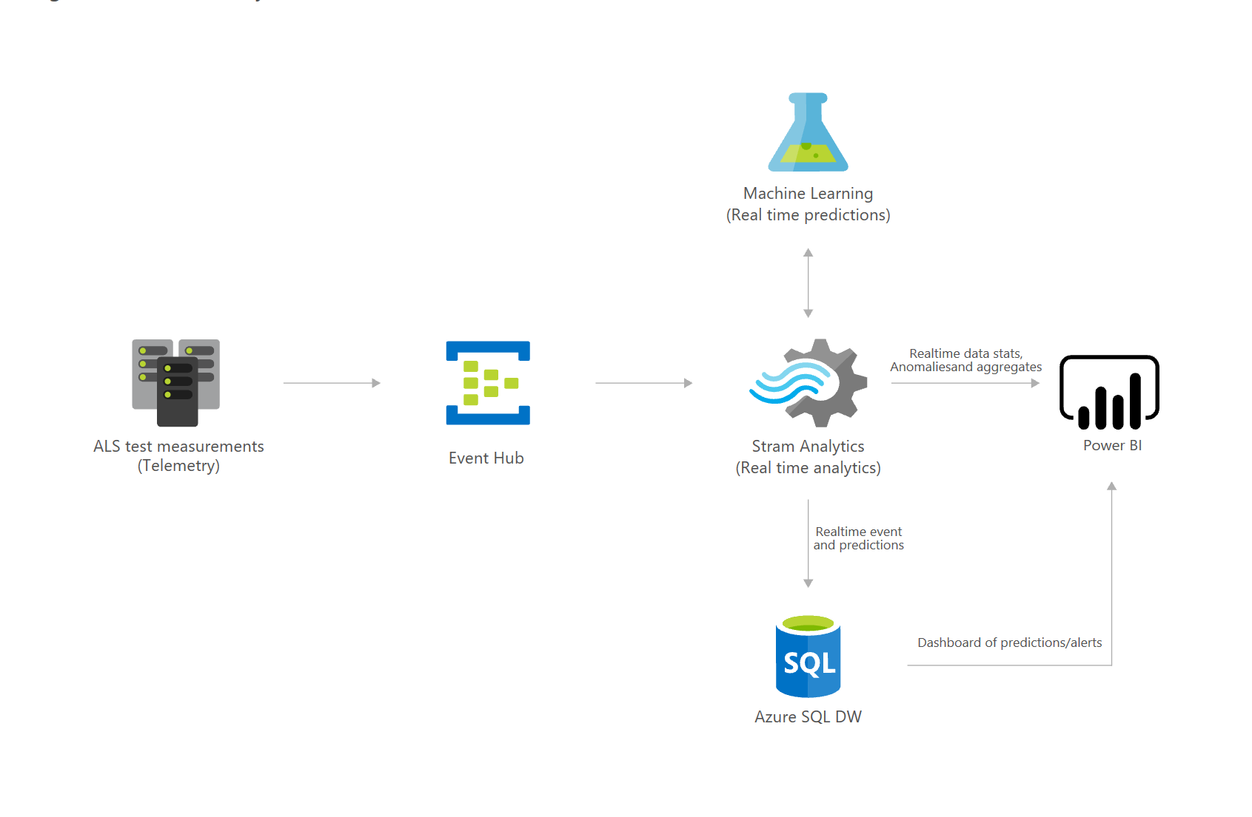
Solution architectures
Visit for more: https://azure.microsoft.com/en-us/solutions/architecture/?solution=internet-of-things

Slide 8
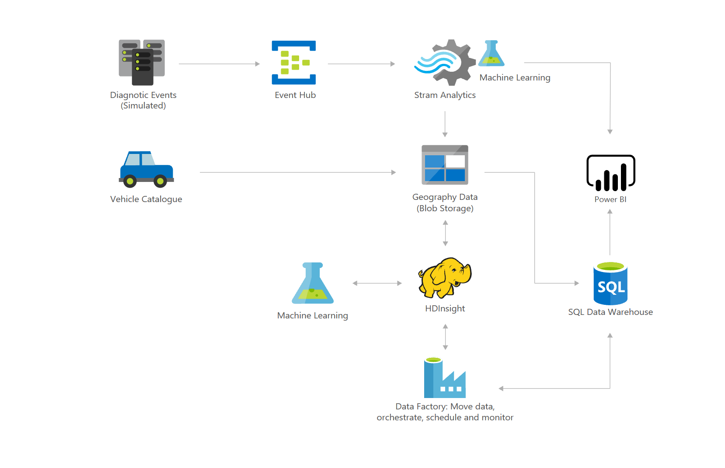
Solution architectures
Visit for more: https://azure.microsoft.com/en-us/solutions/architecture/?solution=internet-of-things

Slide 9
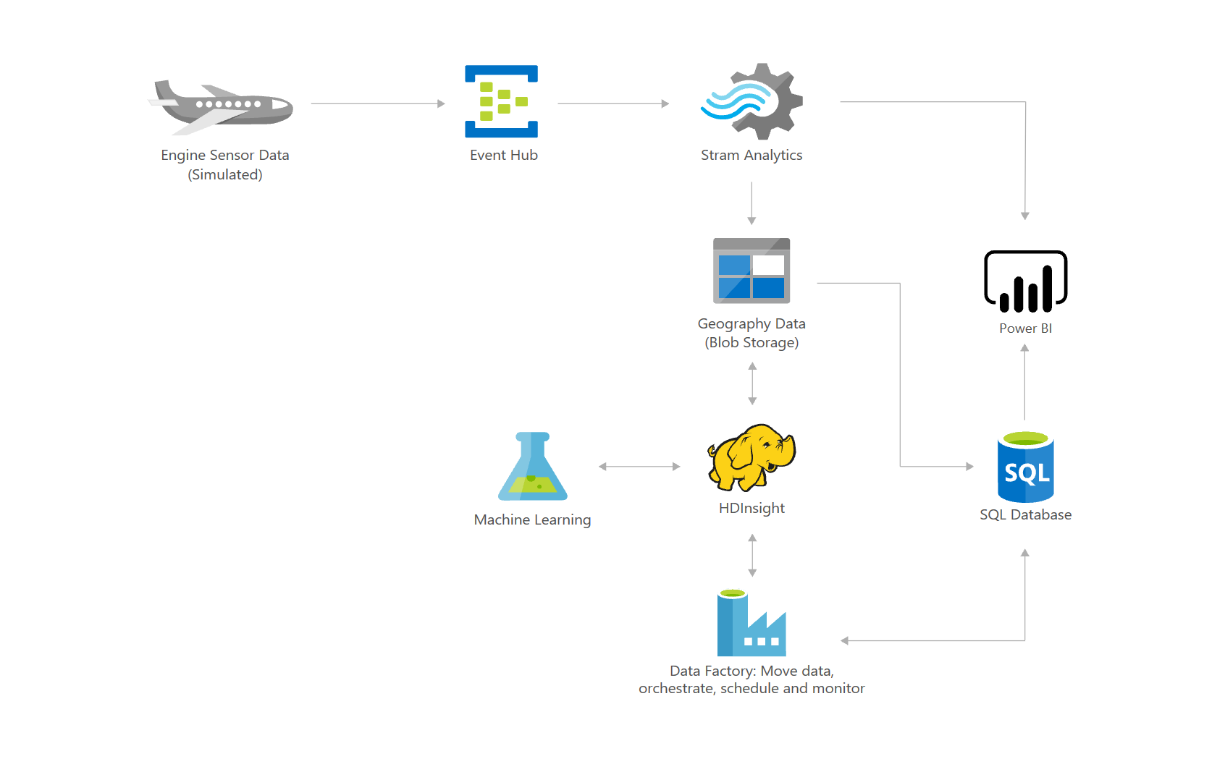
Solution architectures
Visit for more: https://azure.microsoft.com/en-us/solutions/architecture/?solution=internet-of-things

